Slide 1
Security baseline on Azure
Notes:
Information in this document, including URL and other Internet Web site references, is subject to change without notice. Unless otherwise noted, the example companies, organizations, products, domain names, e-mail addresses, logos, people, places, and events depicted herein are fictitious, and no association with any real company, organization, product, domain name, e-mail address, logo, person, place or event is intended or should be inferred. Complying with all applicable copyright laws is the responsibility of the user. Without limiting the rights under copyright, no part of this document may be reproduced, stored in or introduced into a retrieval system, or transmitted in any form or by any means (electronic, mechanical, photocopying, recording, or otherwise), or for any purpose, without the express written permission of Microsoft Corporation.
Microsoft may have patents, patent applications, trademarks, copyrights, or other intellectual property rights covering subject matter in this document. Except as expressly provided in any written license agreement from Microsoft, the furnishing of this document does not give you any license to these patents, trademarks, copyrights, or other intellectual property.
The names of manufacturers, products, or URLs are provided for informational purposes only and Microsoft makes no representations and warranties, either expressed, implied, or statutory, regarding these manufacturers or the use of the products with any Microsoft technologies. The inclusion of a manufacturer or product does not imply endorsement of Microsoft of the manufacturer or product. Links may be provided to third party sites. Such sites are not under the control of Microsoft and Microsoft is not responsible for the contents of any linked site or any link contained in a linked site, or any changes or updates to such sites. Microsoft is not responsible for webcasting or any other form of transmission received from any linked site. Microsoft is providing these links to you only as a convenience, and the inclusion of any link does not imply endorsement of Microsoft of the site or the products contained therein.
© 2019 Microsoft Corporation. All rights reserved. Microsoft and the trademarks listed at https://www.microsoft.com/en-us/legal/intellectualproperty/Trademarks/Usage/General.aspx are trademarks of the Microsoft group of companies. All other trademarks are property of their respective owners.

Slide 2
Abstract and learning objectives
In this whiteboard design session, you will work with a group to design an end-to-end solution that leverages many of Microsoft Azure’s security features.
At the end of this session, you will be better able to design and recommend solutions that help organizations properly secure their cloud-based applications while protecting their sensitive data.

Slide 3
Step 1: Review the customer case study
Outcome
Analyze your customer needs.
Timeframe
15 minutes

Slide 4
Customer situation
Contoso is a multinational insurance corporation, headquartered in the United States that provides insurance solutions worldwide.
Agents and employees access on-premises web applications via mobile and browser access to query customer policy information over the internet and VPN.
Admins utilize both corporate and personal machines to perform their daily duties.

Slide 5
Customer situation (#2)
Contoso currently hosts their systems at colocations facilities within each geopolitical region and manage all IT operations for the system.
Exploring a move to Microsoft Azure to simplify some of the operations management overhead and associated costs across both U.S. and European data centers.
Concerns about regional issues of data sovereignty for sensitive data within the context of the GDPR.
Concerns about maintaining their SOC 2 certification and HIPAA compliance.

Slide 6
Customer needs
Assure data privacy and protection across all aspects of the system; in transit and at rest.
Address issues of data sovereignty with respect to the location of sensitive data.
Ability to scale as the company grows and system load increases.
Contain hosting and operational costs associated with running the system.
Enable method to continually review and assign legal compliance tasks to the appropriate individuals and provide a compliance reporting ability for Azure resources.

Slide 7
Customer needs (#2)
Enforce subscription owners to configure Azure resources with compliance and security while disallowing the creation of specific resources.
Ensure that any cloud-based identities utilize the same on-premises username and passwords and limit any help desk interactions.
Limit access to the corporate site to users on the Contoso domain, and continue to support VPN access.
Extract all web applications that have configuration or embedded connection strings to a more secure implementation.
Migrate current database applications to Azure PaaS solution with the appropriate data backup features implemented to prevent catastrophic data loss due to intentional or unintentional acts.

Slide 8
Customer needs (#3)
Implement all security best practices on the migrated databases such as encryption at rest and during transport as well as ensure that sensitive data is not exposed to non-admin database users and applications.
Ensure network segregation between Azure admin and the lift and shifted web and database tiers.
Enable logging across all components (identity, virtual network, virtual machine, web, and database) to support an all-encompassing monitoring solution.
Ensure that Azure admins utilize best practices when accessing the Azure virtual machine resources and that all logins are logged for identity theft analysis activities.
Ensure ease of use by syncing appropriate admin username and passwords for on-premises and cloud resources.

Slide 9
Customer needs (#4)
Ensure that only authorized users can access specific Azure resources when logged into the Azure Portal.
Setup auditing such that software installs are monitored across Azure virtual machine resources.
When specific security events are detected (such as a port scan), allow for the execution of actions to remediate, start the investigative process or prevent further information leakage or damage

Slide 10
Customer objections
Can Azure support the lift and shift of their web and database applications?
Is Azure SQL secure enough to host their application databases?
Admins are worried that they won't have the bandwidth to perform deployments of the corporate website and other supporting web applications.
Can Azure help contain costs for minimally used costly production and development resources?
Does Azure support the ability to allow VPN connections to specific resources?

Slide 11
Customer objections (#2)
Can Microsoft employees or government entities access our data?
How does Azure protect against threats?
Does Azure allow enough granular RBAC controls to meet our least privilege needs?
Is Azure virtual networking flexible enough to meet our requirements?
Can Azure supplement on-premises and third-party SIEM systems for auditing and compliance tasks?

Slide 12
Customer objections (#3)
What certifications does Azure have and can Azure hosted applications meet the US and European compliance goals?
Is Azure flexible enough to support data sovereignty needs and issues like those referenced in GDPR articles?
How can we ensure continued SOC 1 and SOC 2 compliance?
Does Azure permit penetration testing as a part of a security assessment?

Slide 13
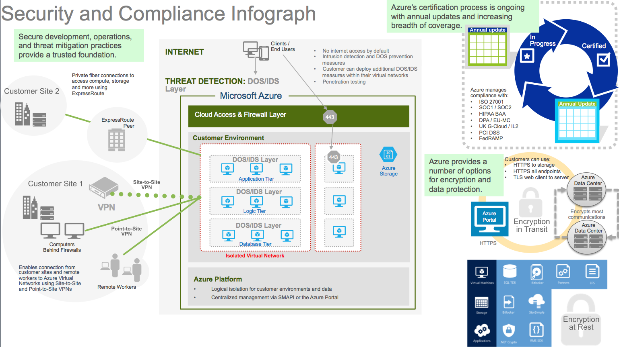
Common scenarios

Slide 14
Step 2: Design the solution
Outcome
Design a solution and prepare to present the solution to the target customer audience in a 15-minute chalk-talk format.
Timeframe
60 minutes
Business needs (15 minutes) | Respond to questions outlined in your guide and list the answers on a flipchart.
Design (35 minutes) | Design a solution for as many of the stated requirements as time allows. Show the solution on a flipchart.
Prepare (15 minutes) | Identify any customer needs that are not addressed with the proposed solution. Identify the benefits of your solution. Determine how you will respond to the customer’s objections. Prepare for a 15-minute presentation to the customer.

Slide 15
Step 3: Present the solution
Outcome
Present a solution to the target customer in a 15-minute chalk-talk format.
Timeframe
30 minutes (15 minutes for each team to present and receive feedback).
Directions
Pair with another table.
One table is the Microsoft team, and the other table is the customer.
The Microsoft team presents their proposed solution to the customer.
The customer asks one of the objections from the list of objections in the case study.
The Microsoft team responds to the objection.
The customer team gives feedback to the Microsoft team.

Slide 16
Wrap-up
Outcome
Identify the preferred solution for the case study.
Identify solutions designed by other teams.
Timeframe
15 minutes

Slide 17
Preferred target audience
Jack Tradewinds, CIO of Contoso Insurance
The primary audience is business decision makers and technology decision makers.
Usually, we talk to the Infrastructure Managers who report to the CIOs, or to application sponsors (like a VP LOB, CMO) or to those that represent the Business Unit IT or developers that report to application sponsors.

Slide 18
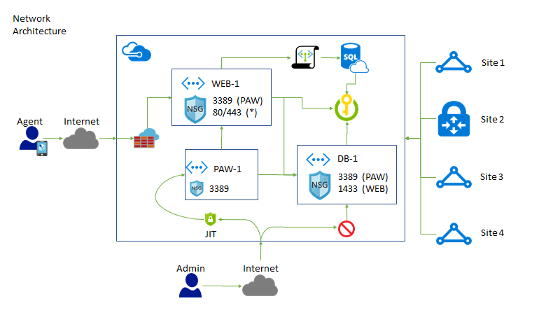
Preferred solution (Network/Security)
Notes:
In this diagram, all internet based web traffic is routed to the Azure Firewall. From there, it is then forwarded to the back-end web servers and applications.
Admin access is locked down via Just in Time (JIT) access to the PAW machine.
Virtual Networks and Network Security Groups limit traffic such that you can only gain access to the PAW machine before you can gain access to any other machines.
Admins can access the Azure Resource Group and resources via Site-to-Site, Point-to-Site and Azure ExpressRoute communications.
Key vault is used to hold all database connection strings and the Web server utilizes MSI identities tied to the virtual machine to gain access to the key vault.

Slide 19
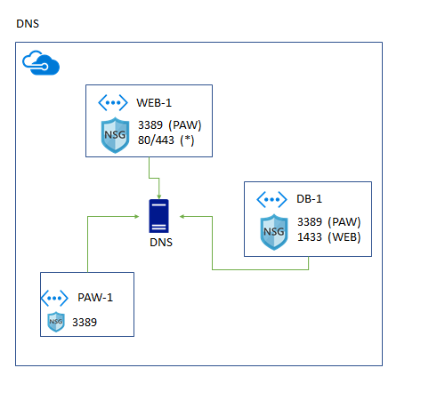
Preferred solution (Network/DNS)
Notes:
Because of the use of multiple virtual networks, a DNS server has been configured to help the various resources.

Slide 20
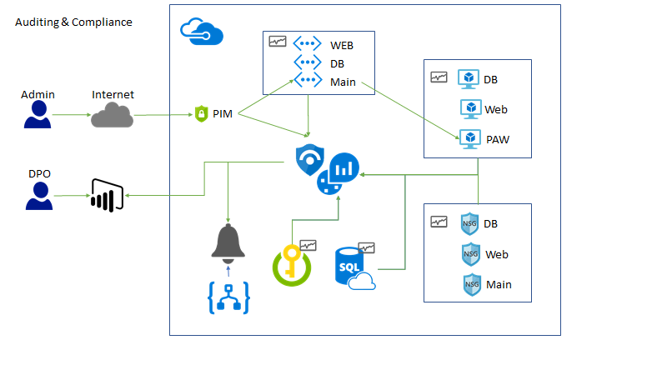
Preferred solution (Auditing & Compliance)
Notes:
In this diagram, admins that connect through the internet are required to use Privileged identity management (PIM) to elevate to admin permissions.
A Data Protection Officer (DPO) connects through Power BI reports to see pre-built reports based on queries built in Azure Sentinel and Log Analytics.
All Azure resources have Diagnostic logging enabled and pointed at a single Log Analytics workspace.
Alerts are also setup to monitor for security events and notify the appropriate admins.

Slide 21
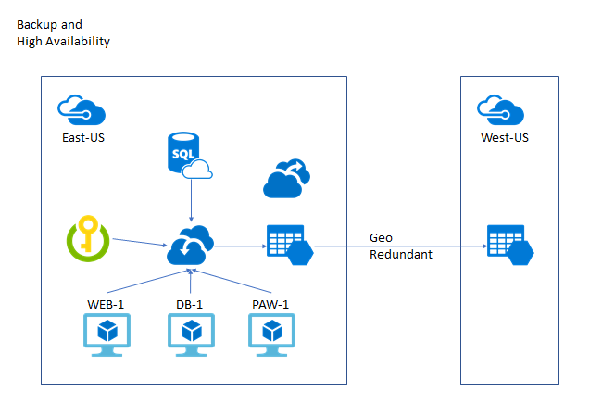
Preferred solution (Availability and Bus Cont.)

Slide 22

Preferred solution
Securing Sensitive Data
Azure VMs for their corporate and data collection websites.
Azure Virtual Networking with NSGs to segregate network traffic.
Azure SQL for databases with TDE, Data Masking, encryption at rest and NSGs for restricted access.
Web applications with Azure Key Vault integration for storing connection strings with Managed Service Identities (MSI) controlled access
Azure Firewall to filter internet traffic
Notes:
Topology Notes
Where available Azure Express Route to ensure connectivity.
Site-to-Site and Point-to-Site VPNs for other office locations.

Slide 23

Preferred solution (#2)
Ensuring Auditing and Compliance
Azure Security Center Just In Time (JIT) VM Access
Utilize Privileged Identity Management (PIM) and IAM roles
Custom Alerts with Azure Security Center
Azure Monitor for network and packet capture
Azure Monitor with Power BI on Azure resource events

Slide 24
Preferred solution (#3)
Ensuring Auditing and Compliance
Azure Sentinel for incident and case investigation
Auditing and Threat detection enable on Azure SQL
Azure Diagnostics enabled on all resources
Azure Runbooks that execute based on alerts
Implement Azure Policy, Compliance Manager, Secure Score

Slide 25
Preferred solution (#4)
Ensuring Availability and Business Continuity
Azure Recovery Service Vault for VM backups
Azure Recovery Service Vault for hourly log backups
Azure SQL geo-replication for high-availability and redundancy

Slide 26
Preferred solution (#5)
Ensuring Protection
Enable Azure Premium Subscription (MFA) on admin credentials
Enable Azure AD Identity Protection
Enable Adaptive Application controls on VMs
Auto provision Microsoft Monitoring Agent on new and existing VMs
Utilize Privileged Access Workstations (PAW) Jump VMs

Slide 27
Preferred solution (#6)
Ensuring Protection
Use Microsoft Intune to force compliant devices only and conditional access policies
Use Microsoft Antimalware

Slide 28
Preferred solution (#7)
Data sovereignty
Contoso to continue operation with regional offices for its data, migrating to Azure those offices (particularly those in the US and the EU) whose regional privacy laws can be satisfied by Azure.

Slide 29
Preferred objections handling
Can Azure support the lift and shift of their web and database applications?
Is Azure SQL secure enough to host their application databases?
Admins are worried that they won’t have the bandwidth to perform deployments of the corporate website and other supporting web applications.
Can Azure help contain costs for minimally used costly production and development resources?
Notes:
Can Azure support the lift and shift of their web and database applications?
Yes, and it is the next logical step for many organizations in their cloud journey:
There are many programs that customers can take advantage of to help with the move Azure including
Microsoft FastTrack for Azure
Azure Migrate
Is Azure SQL secure enough to host their application databases?
Transparent data encryption performs real-time encryption and decryption of the database, associated backups, and transaction log files to protect information
at rest. Transparent data encryption provides assurance that stored data hasn't been subject to unauthorized access.
Firewall rules prevent all access to database servers until proper permissions are granted. The firewall grants access to databases based on the originating IP
address of each request.
Encrypted columns ensure that sensitive data never appears as plain text inside the database system. After data encryption is enabled, only client applications or
application servers with access to the keys can access plain-text data.
Dynamic data masking limits sensitive data exposure by masking the data to nonprivileged users or applications. It can automatically discover potentially sensitive
data and suggest the appropriate masks to be applied. Dynamic data masking helps to reduce access so that sensitive data doesn't exit the database via unauthorized access. Customers are responsible for adjusting settings to adhere to their database schema.
Admins are worried that they won’t have the bandwidth to perform deployments of the corporate website and other supporting web applications.
Azure ExpressRoute can be used to create private connections between Azure datacenters and infrastructure on your premises or in a colocation environment. ExpressRoute connections don't go over the public Internet, and they offer more reliability, faster speeds, and lower latencies than typical Internet connections. In some cases, using ExpressRoute connections to transfer data between on-premises systems and Azure can give you significant cost benefits.
Can Azure help contain costs for minimally used costly production and development resources?
Yes, Azure Cost Management + Billing has free features via the Cloudyn application that allows you to monitor your cloud spend, drive organizational accountability and optimize your cloud efficiency.

Slide 30
Preferred objections handling (#2)
Does Azure support the ability to allow VPN connections to specific resources?
Can Microsoft employees or government entities access our data?
How does Azure protect against threats?
Does Azure allow enough granular RBAC control to meet our least privilege needs?
Is Azure virtual networking flexible enough to meet our requirements?
Notes:
Does Azure support the ability to allow VPN connections to specific resources?
Yes, Azure provides the ability to do site-to-site IPSec VPNs and the ability to create point-to-site VPNs. By utilizing a site-to-site VPN Gateway you can connect your on-premises networks with Azure utilizing IPSec and IKE. Point-to-site will allow individual client computers to connect to your Azure virtual network(s) via SSTP or IKE.
Can Microsoft employees or government entities access our data?
Access to customer data by Microsoft operations and support personnel is denied by default. When granted, access is carefully managed and logged. Data center access to the systems that store customer data is strictly controlled via lock box processes.
Microsoft does not share data with third parties unless permitted by the customer.
Microsoft provides only the data it is legally compelled to provide, but never voluntarily.
Both employees and subcontractors work at Microsoft data centers.
We require subcontractors to join Microsoft's Vendor Privacy Assurance Program, to meet our privacy requirements by contract, and to undergo regular privacy training. We contractually obligate subcontractors that work in facilities or on equipment controlled by Microsoft to follow our privacy standards. All other subcontractors are contractually obligated to follow privacy standards equivalent to our own.
How does Azure protect against threats?
Intrusion detection and prevention systems, denial of service attack prevention, regular penetration testing, and forensic tools help identify and mitigate threats from both outside and inside of Azure.
Microsoft Antimalware is built-in to Cloud Services and can be enabled for Virtual Machines to help identify and remove viruses, spyware and other malicious software and provide real-time protection. Customers can also run antimalware solutions from partners on their Virtual Machines.
Microsoft has decades of operating system security experience running its own applications and services and latest developments allow the Microsoft Security Graph to analyze events to determine if and when an attack is occurring.
Does Azure allow enough granular RBAC controls to meet our least privilege needs?
Azure resource groups can be set up with users, groups, and applications with varying levels of role assignments to meet any customer requirements.
Azure comes with several pre-built built-in roles - https://docs.microsoft.com/en-us/azure/active-directory/role-based-access-built-in-roles and allows you to create custom roles - https://docs.microsoft.com/en-us/azure/active-directory/role-based-access-control-custom-roles
Additionally, you have the ability to assign individual users and groups to just about any Azure resource.
Is Azure virtual networking flexible enough to meet our requirements?
Azure Virtual Network gives you an isolated and highly-secure environment to run your virtual machines and applications. Use your private IP addresses and define subnets, access control policies, and more. Use Virtual Network to treat Azure the same as you would your own datacenter.
Traffic between Azure resources in a single region, or in multiple regions, stays in the Azure network—intra-Azure traffic doesn’t flow over the Internet. In Azure, traffic for virtual machine-to-virtual machine, storage, and SQL communication only traverses the Azure network, regardless of the source and destination Azure region. Inter-region virtual network-to-virtual network traffic also flows entirely across the Azure network.
In a virtual network, run your favorite network virtual appliances such as WAN optimizers, load balancers, and application firewalls and define traffic flows, allowing you to design your network with a greater degree of control.
Use Virtual Network to build your hybrid cloud applications that securely connect to your on-premises datacenter—so an Azure web application can access an on-premises SQL Server database, or authenticate customers against an on-premises Azure Active Directory service.

Slide 31
Preferred objections handling (#3)
Can Azure supplement on-premises and 3rd party SIEM systems for auditing and compliance tasks?
What certifications does Azure have and can Azure hosted applications meet the US and European compliance goals?
Is Azure flexible enough to support data sovereignty needs and issues like those referenced in GDPR articles?
How can we ensure continued SOC 1 and SOC 2 compliance?
Does Azure permit penetration testing as a part of a security assessment?
Notes:
Can Azure supplement on-premises and 3rd party SIEM systems for auditing and compliance tasks?
Yes, Azure has a robust set of integration scenarios for customers including:
Command Line Interface (CLI), PowerShell and a REST API
Email and webhooks based on triggers
Events streamed to Event Hub
PowerBI integration
Events saved to a Storage Account for analysis later
Export data using Log Profiles with Log Analytics
What certifications does Azure have and can Azure hosted applications meet the US and European compliance goals?
Certifications:
U.S. Specific Certifications
Cloud Security Alliance CCM
HIPAA BAA
FedRAMP
FISMA
FBI CJIS
FERPA
FIPS 140-2
FDA 21 CFR Part 11
International Certifications
PCI DSS Level 1
ISO 27001 / 27002
SOC 1 / SSAE 16 / ISAE 3402 and SOC 2
EU Model Clauses
United Kingdom G-Cloud / IL2
Australian Government IRAP
Singapore MTCS Standard
China Cloud Computing and Policy Forum (CCCPPF)
MLPS (China)
Azure hosted applications can meet compliance goals is designed and maintained properly.
Is Azure flexible enough to support data sovereignty needs and issues like those referenced in GDPR articles?
Microsoft was among the first cloud providers to sign a set of EU “model clauses,” which are standard contractual clauses that govern the international transfer of personal data. When included in service agreements with data processors, the model clauses assure customers that appropriate steps have been taken to help safeguard personal data, even if data is stored in a cloud-based service center located outside the EEA. In affirming these, a data processor is affirming that they are meeting the data protection standards set forth by the EU Directive on Data Protection.
Microsoft has UK Government IL2 certification. UK Government Departments require products and services to be accredited to IL2 or IL3. These terms, Business Impact Levels 2 or 3, essentially require the telecoms operator or service provider to pass an audit based on ISO 27k as additionally extended by the NGN Good Practice Guide.
How can we ensure continued SOC 1 and SOC 2 compliance?
To maintain SOC 1 and SOC 2 compliance, there are auditing requirements for the customer. To address this need, Microsoft makes certificates and audit reports available in support of the customer's own reports and certifications.
ISO/IEC 27001:2005 Audit and Certification certificates are publicly available.
SOC 1 and SOC 2 reports are available under NDA to customers to meet auditing requirements.
Customers cannot audit the data center. However independent audits and certifications are shared instead of individual customer audits. These certifications and attestations accurately represent how Microsoft obtains and meets security and compliance objectives, and serve as a practical mechanism to validate Microsoft promises for all customers. Allowing potentially thousands of customers to audit Microsoft services would not be a scalable practice and might compromise security and privacy. The independent third-party validation program includes audits that are conducted on an annual basis to verify Azure security controls.
Does Azure permit penetration testing as a part of a security assessment?
Yes, and as of mid-2017, you no longer need to get approval to execute these tests, but you can still notify Microsoft if you are planning to do so.

Slide 32
Customer quote
“We are moving into the secure digital world with Azure, helping our agents ensure the security and protection of client personal information and protecting them from the unpredictable and unforeseen events of life.”
- Jack Tradewinds, CIO of Contoso Insurance

